Slide 1




Le MLOps est avant tout une aventure humaine
ML = Machine Learning
Guillaume Chervet
TechLead – ML Engineer
Direction Transfo et Tech - AXA France
@guiChervet
Conférence Tech Challenger 1er décembre 2022
Notes:
What is MLOps? This is all things that will help and support the fact of bringing artificial intelligence algorithms into production, it is not about tools or technologies; it is mainly a question of culture and good practice.
Hi, my name is Guillaume Chervet, I'm an ML engineer at AXA France. Basically, I define my role as helping data scientists to bring AI algorithms into production.
I‘m part of a team that works on real-time automatic document understanding projects. Generally, this kind of projects implements one or more Deep Learning algorithms.
Today, almost 80% of projects fail at the production stage. This does not surprise me because, this kind of projects are on the top complexities in all areas, all factors are met to make them fail.

Slide 2
Stake 1
Software Engineer
Data Scientist
Ops
Le MLOps est une aventure Humaine – Guillaume Chervet - 1er Décembre 2022
Notes:
The first problem is a human problem, so today most applications require Developers and Operation engineers and it's already not easy to get everyone working together. On AI projects, we should also add a lot of expertise about data. We need Data experts.
Today, it’s almost impossible to be an expert in these 3 areas. Each party will have to trust one another and accept other party’s constraints.

Slide 3
Email classification
Stake 2
Training env. (AzureML) | Production env. (OpenShift) | Total default run cost
2700 € / month | 6000 € / month (dev, staging, pre-prod, prod) | 8 700 € / month
Le MLOps est une aventure Humaine – Guillaume Chervet - 1er Décembre 2022
Notes:
The second problem is the fact that we work on projects that are generally extremely expensive.
This is an email classification project that worked very well. For us, it's an example project to follow.
Today the operating cost of the project per month is approximately 9 000 €, that’s a little more than 100,000 € per year. I think that we can still divide the costs by 2. Today on this project we classify about 10,000 emails per day. So, we estimate that each email classification costs about 3 cents euro.
For example, If we decide to carry out one “model retrain” per year, the cost of one email classification will increase to 4 cents euro. And here, I’m excluding the first implementation of the project… which cost a little more than 1 000 000 euros!

Slide 4

Classification
Claims Contract
Invoice
Attachment
Other
email
"envelope upside an old white paper"
Le MLOps est une aventure Humaine – Guillaume Chervet - 1er Décembre 2022
Notes:
Here is a functional example of a mail classification
.
For your information, all images you see here with a small text below are generated by an artificial intelligence algorithm.

Slide 5
Today Agenda
Introduction to AI and Deep Learning
Production architecture constraints
AXA Lessons Learned in MLOps
Recipes to fail an ML project
How to stack the odds in your favor ?
Le MLOps est une aventure Humaine – Guillaume Chervet - 1er Décembre 2022
Notes:
In this part we are going to give feedbacks based on different experiences. This allowed us to learn what NOT to do.
To make it fun, we are going to open a pizzeria and we are going to organize to serve pizzas to our customers. We're going to put everything in place to make our pizzeria fails to deliver a good meal.

Slide 6
Today Agenda
Introduction to AI and Deep Learning
Production architecture constraints
AXA Lessons Learned in MLOps
Recipes to fail an ML project
How to stack the odds in your favor ?
Le MLOps est une aventure Humaine – Guillaume Chervet - 1er Décembre 2022
Notes:
In this part we are going to give feedbacks based on different experiences. This allowed us to learn what NOT to do.
To make it fun, we are going to open a pizzeria and we are going to organize to serve pizzas to our customers. We're going to put everything in place to make our pizzeria fails to deliver a good meal.

Slide 7
Deep Learning
Artificial Intelligence
Machine Learning
Deep Learning
Le MLOps est une aventure Humaine – Guillaume Chervet - 1er Décembre 2022
Notes:
One of the subsets of artificial intelligence is machine learning and one of the subsets of machine learning is deep learning.

Slide 8
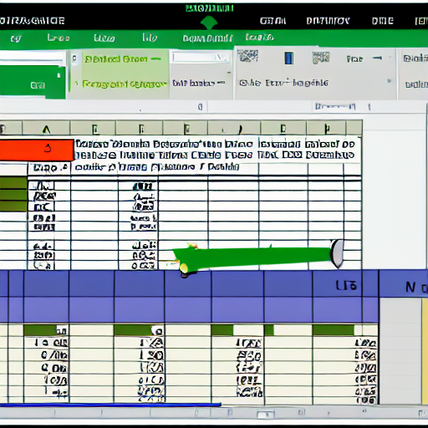
Deep Learning
Structured data
"excel structured data"
Le MLOps est une aventure Humaine – Guillaume Chervet - 1er Décembre 2022
Notes:
You will often hear about structured data usually being represented by an Excel file. In general, for this kind of problem where there is a limited number of inputs/outputs. We will use simple machine learning algorithms.

Slide 9



Deep Learning
Unstructured data
"text from an old book on a table"
"camera outside on the beach"
"big music speaker"
Le MLOps est une aventure Humaine – Guillaume Chervet - 1er Décembre 2022
Notes:
When we have data like: sounds, images, videos. The number of possible inputs/outputs is generally higher. Consequently, we will generally use Deep learning algorithms which use neural networks.

Slide 10
3 Paradigm shift
Deep Learning
Le MLOps est une aventure Humaine – Guillaume Chervet - 1er Décembre 2022
Notes:
slide / ! \ Attention changement important. Mettre un marqueur pour y revenir ensuite à la fin.

Slide 11

Deep Learning
1) Paradigm shift : Skills and organisation and collaboration
Classical programming
Rules
Answers
Data
Source : François Chollet
Source : François Chollet
Le MLOps est une aventure Humaine – Guillaume Chervet - 1er Décembre 2022
Le MLOps est une aventure Humaine – Guillaume Chervet - 1er Décembre 2022
Notes:
When we work on classic code, in general, we have rules, plus input data. Then we write an algorithm that will allow us to generate answers.
In machine learning, it's a little bit different, we need input data and a lot of answers. Not just a little number, really a lot, thousands of examples 10,000, 100,000 or even more. These inputs allow to write code that will be able to generate the rules: an artificial intelligence, we will technically speak of a generating a “model”.

Slide 12

Deep Learning
1) Paradigm shift : Skills and organisation and collaboration
Classical programming
Rules
Answers
Data
Machine Learning
Data
Rules
Answers
Source : François Chollet
Le MLOps est une aventure Humaine – Guillaume Chervet - 1er Décembre 2022
Notes:
When we work on classic code, in general, we have rules, plus input data. Then we write an algorithm that will allow us to generate answers.
In machine learning, it's a little bit different, we need input data and a lot of answers. Not just a little number, really a lot, thousands of examples 10,000, 100,000 or even more. These inputs allow to write code that will be able to generate the rules: an artificial intelligence, we will technically speak of a generating a “model”.

Slide 13
Deep Learning
Code
Data
Answer
AI model
Data
Answer
Le MLOps est une aventure Humaine – Guillaume Chervet - 1er Décembre 2022
Notes:
In production, classic code or AI is used in the same way.
We receive an input, we execute the algorithm, and then we get the result.

Slide 14

Deep Learning
2) Paradigm shift : Data
Le MLOps est une aventure Humaine – Guillaume Chervet - 1er Décembre 2022
Notes:
In the past, we used to talk about project as “model centric”, because we weren't sure we could make an appropriate AI.
Today most of the points on the AI ​​side: at least for our needs at AXA France, already have viable solutions. We know that we will be able to create an AI for our use cases.
On the other hand, the heart of the problem, really the thing that makes a project feasible or not: it is the data. If we have good data, of good quality, inputs and answers, a lot, that will really be game changer to the success of your project. The data is your treasure that will make the difference.

Slide 15
Deep Learning
collect
Datasets
Le MLOps est une aventure Humaine – Guillaume Chervet - 1er Décembre 2022
Notes:
So now, we are going to explain the workflow of a project. We want to build an email classification project.
The first thing to do is to retrieve data: inputs and answers. On this project, it was easy. We already had emails and answers because in production we already have humans who have been classifying the emails manually for several years. So, we already have the data and the answers, that's perfect to build up our first dataset.

Slide 16
Deep Learning
collect
Datasets
use
Train AI
Le MLOps est une aventure Humaine – Guillaume Chervet - 1er Décembre 2022
Notes:
Then, with this data, we will be able to iterate to create an AI and build an API that we can put into production.

Slide 17
Deep Learning
collect
Datasets
use
Train AI
deploy
Production AI API
Le MLOps est une aventure Humaine – Guillaume Chervet - 1er Décembre 2022

Slide 18
Deep Learning
collect
Datasets
use
Train AI
deploy
Production AI API
use
Consumer Production application
Le MLOps est une aventure Humaine – Guillaume Chervet - 1er Décembre 2022
Notes:
After that, our application in production can be consumed by client applications.

Slide 19
Deep Learning
collect
Datasets
use
Train AI
deploy
Production AI API
use
Consumer Production application
collect
Feedback Loop
Le MLOps est une aventure Humaine – Guillaume Chervet - 1er Décembre 2022
Notes:
In production, it is extremely important to set up what is called: the “feedback loop”. A virtuous circle. In the event of a classification error, the client applications must allow the error to be corrected manually. Over time, we will be able to build new dataset of a better quality and we will be able to improve our Artificial Intelligence.

Slide 20
Demo
Deep Learning
Source :
Dogs vs. Cats | Kaggle
Le MLOps est une aventure Humaine – Guillaume Chervet - 1er Décembre 2022
Notes:
We're going to do a demo of how a project workflow based on a well-known cat and dogs dataset from Kaggle.

Slide 21
Dataset of 20 000 files
Deep Learning
Train a model
13 000 train
4 000 test
3 000 validation
Le MLOps est une aventure Humaine – Guillaume Chervet - 1er Décembre 2022
Notes:
Before starting the demo. Imagine that we have 20,000 files available. We will use 17,000 files for training the model. Then we will keep 3000 files aside for validation, to test our model on data it has never seen. This validation DATASET will also be used to test our production environments.

Slide 22

Deep Learning
Ecotag
Deep Learning
3) Paradigm shift : It’s alive
Le MLOps est une aventure Humaine – Guillaume Chervet - 1er Décembre 2022
Notes:
Changement : c’est vivant, comme qqun qui apprend, il doit continuer à s’adapter. Et donc on doit relivrer fréquemment pour s’adapter aux nouvelles data.

Slide 23

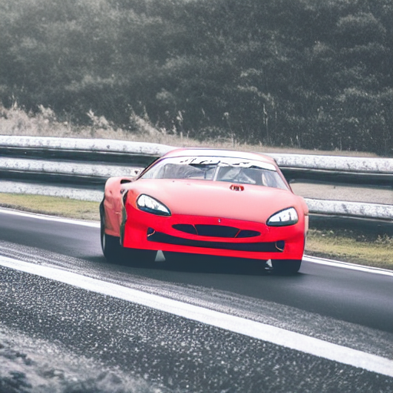
Deep Learning
Data drift
"a race car drift deep on a road in a bend"
Le MLOps est une aventure Humaine – Guillaume Chervet - 1er Décembre 2022
Notes:
Slide 20 After Demo Data drift
If we feed our models with different data. Data very different on which models have learned. Predictions may deteriorate.
For our email classification project, for example, if there is a change of layout for the accident report, it is possible that the AI ​​will fail to recognize automobile claims. In this case, it is necessary to retrain and then re-deploy model in production.
Let's takes a sample with our Demo. Now let's imagine that our users start using plush or inpainting cats and dogs, as you can see the predictions no longer work correctly.

Slide 24

Deep Learning
"the god graal trophy"
Le MLOps est une aventure Humaine – Guillaume Chervet - 1er Décembre 2022
Notes:
The Holy Grail for us; is to be able to re-train and re-deploy in production without any manual action

Slide 25
Deep Learning
Model of a Datascience Project
Configuration
Data Collection
Data Verification
Machine Resource Management
Serving Infrastructure
Monitoring
Datascience
Analysis Tools
Feature Extraction
Process Management Tools
D’après la source: Google, The Hidden Technical Debt In Machine Learning Systems
Le MLOps est une aventure Humaine – Guillaume Chervet - 1er Décembre 2022
Notes:
This is a Google slide, a Deep learning project is a little bit less than 5% of data science, however it is 100% code!

Slide 26
Today Agenda
Introduction to AI and Deep Learning
Production architecture constraints
AXA Lessons Learned in MLOps
Recipes to fail an ML project
How to stack the odds in your favor ?
Le MLOps est une aventure Humaine – Guillaume Chervet - 1er Décembre 2022
Notes:
In this part we are going to give feedbacks based on different experiences. This allowed us to learn what NOT to do.
To make it fun, we are going to open a pizzeria and we are going to organize to serve pizzas to our customers. We're going to put everything in place to make our pizzeria fails to deliver a good meal.

Slide 27
Prod Constraints
Answer users’ needs
Accurate AI predictions
Cheap
Fast
Secured
Monitored (data drift)
Fast retrain/deployment
Le MLOps est une aventure Humaine – Guillaume Chervet - 1er Décembre 2022
Notes:
The most important thing in a project is to meet user’s needs.
User wants a good prediction quality,
User wants the cheapest project as possible,
User doesn’t want to wait for a result. At AXA France we must answer a prediction in less than 10 seconds for our use-cases.
Safety is non-negotiable.
We want the projects to be monitored. The idea is that if DATA DRIFT starts, this risk causing a production incident. If we are on a major project that can block AXA France, we are not going to wait for the incident to come.
So, the last point, we must be able to re-train and redeploy quickly. If we have a major incident that blocks AXA France, we must be able to re-deploy as quickly as possible and not wait months to unblock the situation.

Slide 28

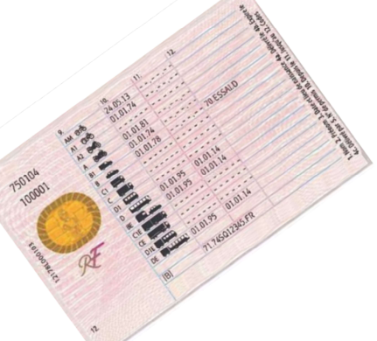





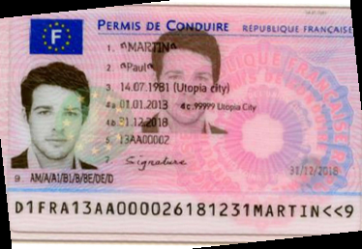
Prod Constraints
Page
Zoning
Homography
Zoning
Zoning
OCR
OCR
Split
Split
Zoning
Homography
Zoning
OCR
Legend :
ML + code
Only code
Le MLOps est une aventure Humaine – Guillaume Chervet - 1er Décembre 2022
Notes:
So there, it’s the functional diagram of the workflow which explains how machines reads a French driving license. We also read the old French driving licenses, but for simplicity we do not display them here.
The idea is that we will receive an image or a PDF as an input. For the first step, we extract each PDF page as an image. On each image we will run a zoning algorithm to detect the fronts and backs. Now, let's take the front at the bottom, we will first straighten the image of the front with a specific algorithm. Then run another algorithm to zone the fields. Finally run an OCR to finely extract the text.
If we hosted an API that exposes this service in monolith mode. We would have several problems. The first is the response time, when we call this kind of API in monolith what will happen is that each algorithm will consume all the CPU resources of the machine. The consequence is that the pipeline will run sequentially, if we proceed like that, the response time is greater than 30 seconds.
Another problem is that during these 30 seconds: if another HTTP call arrives to the API; this call will have to wait for the end of the first processing before to start processing. So, you will tell me that we can add machines; but another problem and if we host this in monolith mode, we need machines with about 32 gigabytes of RAM, which is very expensive. That kind of monolith is also very slow to start. It's going to be very complicated to be able to scale quickly and to adapt infrastructure to user’s load.
The solution is to set up microservices. We will host each algorithm using different resources which allow us to finely configure the necessary RAM and CPU. We will be able to play the algorithms in parallel and to scale quickly. Response time will be quicker.

Slide 29


Prod Constraints
input
output
Function
Queue A
Queue B
Le MLOps est une aventure Humaine – Guillaume Chervet - 1er Décembre 2022
Notes:
How does it technically work? We use functions. Each algorithm is hosted on a function. This function listens to a Queue as input and as soon as it has free time, it will be able to pop the messages that come from the Queue and to process them.
For example, let’s take the SPLITTER which extracts each page of a PDF an image, the function will retrieve a message with a file identifier from the Queue, the files are stored in REDIS. With the identifier, we will fetch the document from REDIS to run our algorithms and for example if we have a PDF with 2 pages, we will extract 2 images then generate 2 identifiers; push the images into REDIS with them. We finally add 2 messages in the downstream QUEUE to be able to call the following service, in this case the Zoning of the French driver license.

Slide 30
Prod Constraints
Function
Function
input
output
Queue A
Function
Queue B
Function
Le MLOps est une aventure Humaine – Guillaume Chervet - 1er Décembre 2022
Notes:
The advantage of working like this. You can scale quickly and support peak loads. Imagine that suddenly, we receive 500 French driver licenses, the number of functions will increase to be able to unstack the messages more quickly. There is also a financial advantage because you only consume what you need.

Slide 31
PDF, IMAGES
JSON Response
OCR
Input HTTP call
HTTP Callback
Receiver
Orchestrator
Queue
New license - frontside
Queue
Homography
Zoning
Queue
Queue
Splitter
Table Zoning
New license - backside
Queue
Homography
Zoning
Table Rotation
Queue
Queue
Queue
Zoning
Queue
Old license - frontside
Homography
Zoning
Table Classifier
Table Rotation
Queue
Queue
Queue
Queue
Prod Constraints
Le MLOps est une aventure Humaine – Guillaume Chervet - 1er Décembre 2022
Notes:
So that's the architecture diagram. If you find it complicated, that's normal because it's complicated.
I will not describe the entire schema, but in summary, it is an asynchronous architecture.
Look at the top left of the schema. The first POD will receive a document and push it straight into REDIS then, with the file identifier it will add a message in the upstream QUEUE of the splitter. Then the Splitter will retrieve the file, process it, etc. etc.
This architecture works for real time and in Batch mode.

Slide 32
Pain points
Prod Constraints
Le MLOps est une aventure Humaine – Guillaume Chervet - 1er Décembre 2022
Notes:
These projects are not without challenges.
I will present you the 2 most important difficulties that we meet.

Slide 33
Production
Quicker response
Better prediction
Cheaper
Le MLOps est une aventure Humaine – Guillaume Chervet - 1er Décembre 2022
Notes:
First, there is an iron triangle of choice. A cursor to position between the prediction quality, the response time and the cost of the infrastructure in production.
If we want to have the best quality of prediction, we can agree to pay more or lose some response time.
But, if you want to be able to respond more quickly, you must be able to accept either to pay more or to lose prediction quality.
Finally, if we want the project to cost less in production, we must either agree to extend the response processing time or reduce the quality of prediction.

Slide 34
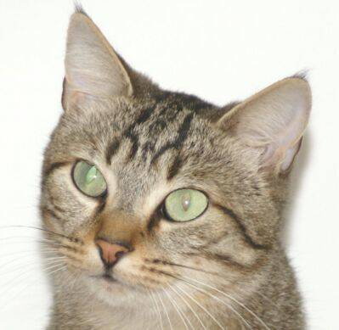
Spot 7 differences
Prod Constraints
Le MLOps est une aventure Humaine – Guillaume Chervet - 1er Décembre 2022
Notes:
So, do you see the differences here?
The differences in these images, we cannot see them, however the AI ​​can!
I had first experience of this problem on our very first project. Pillow library was used to resize images, and which was no longer up to date. As we must always maintain libraires up to dates. As a good developer, I updated it. What happened next, is that predictions did not work anymore. So, I looked at the pictures. Images was identical to my eyes. It was impossible for me to understand what happened. And in fact, for AI images were very different. AI received different bits as an input. The consequence of this problem is that if in production we do not use the same libraries version, python version, and operating system than during training, it may not work.
Back to the demo. The AI ​​algorithm was trained with images resized to 200*200 pixels via Pillow library.
Story: On the driver's license project, we changed all images resize from Pillow library to OpenCV, which allowed us to save a little less than 2 seconds in the global pipeline time.
In this demo I have also implemented a version where images in production are resized with OpenCV before prediction.
Watch, if I predict with images resized via Pillow and then with via OpenCV I don't always get the same results.
I carried out a test with 12500 images and we have around 500 different predictions.

Slide 35
Prod Constraints
Page
Zoning
Homography
Zoning
Zoning
OCR
OCR
Split
Split
Zoning
Homography
Zoning
OCR
Legend :
ML + code
Only code
Le MLOps est une aventure Humaine – Guillaume Chervet - 1er Décembre 2022
Notes:
This only makes 3% prediction differences, but if you take a complex pipeline, where we chain algorithms with different AIs. 3% will propagate thought the pipeline, so at the end the prediction rate becomes very low.

Slide 36
Today Agenda
Introduction to AI and Deep Learning
Production architecture constrains
AXA Lessons Learned in MLOps
Recipes to fail an ML project
How to stack the odds in your favor ?
Le MLOps est une aventure Humaine – Guillaume Chervet - 1er Décembre 2022
Notes:
In this part we are going to give feedbacks based on different experiences. This allowed us to learn what NOT to do.
To make it fun, we are going to open a pizzeria and we are going to organize to serve pizzas to our customers. We're going to put everything in place to make our pizzeria fails to deliver a good meal.

Slide 37
Recipes to fail
Exploration
Industrialization
Deployment & run
Project timeline
Le MLOps est une aventure Humaine – Guillaume Chervet - 1er Décembre 2022
Notes:
To start, we will organize our team. In an AI project, there are 3 main phases. The first phase is the exploration phase, we will test if the project is feasible, then we move on to an industrialization phase and finally we have a “Deployment and Run” phase.
So here, I present to you Elisabeth, Elisabeth is a Data Scientist. We asked her to work alone on the exploration phase.

Slide 38

Recipes to fail
Exploration
"Data scientist girl who cook with a suit in a kitchen, artstation concept art"
Project timeline
Le MLOps est une aventure Humaine – Guillaume Chervet - 1er Décembre 2022
Notes:
To start, we will organize our team. In an AI project, there are 3 main phases. The first phase is the exploration phase, we will test if the project is feasible, then we move on to an industrialization phase and finally we have a “Deployment and Run” phase.
So here, I present to you Elisabeth, Elisabeth is a Data Scientist. We asked her to work alone on the exploration phase.

Slide 39
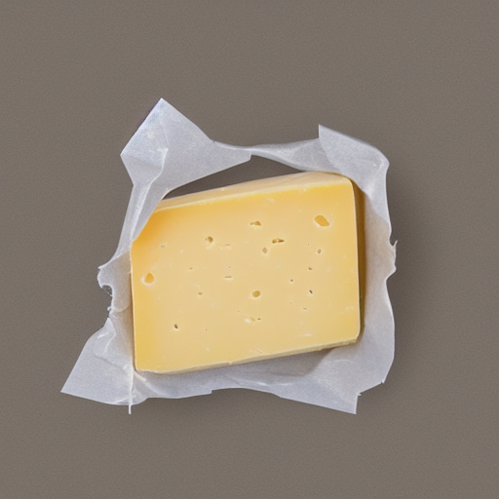
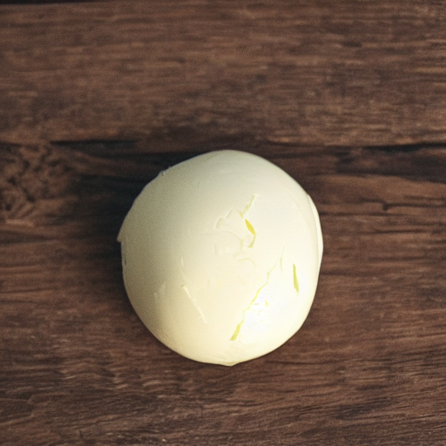

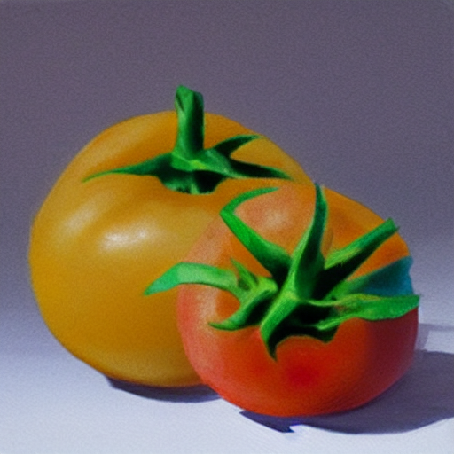
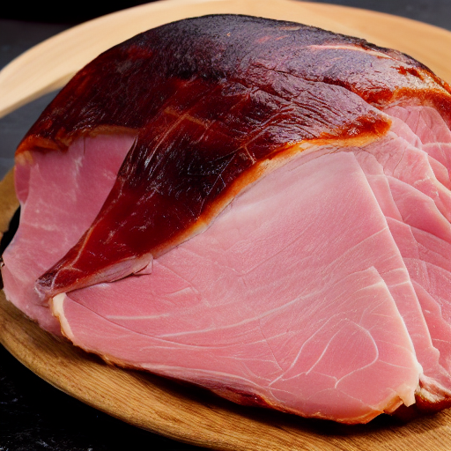
Recipes to fail
Exploration
"Data scientist girl who cook with a suit in a kitchen, artstation concept art"
Project timeline
Le MLOps est une aventure Humaine – Guillaume Chervet - 1er Décembre 2022
Notes:
So, Elisabeth is an excellent cook, we asked her to knead the pizza dough and spread it. She does it very well.

Slide 40
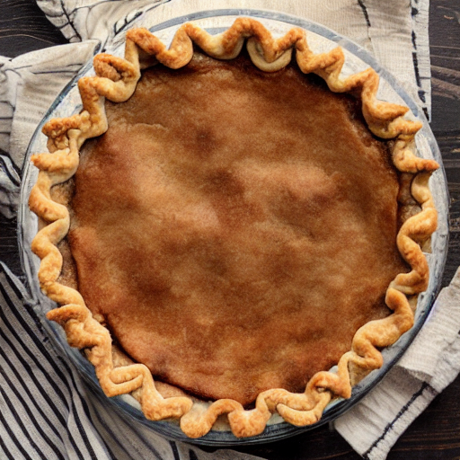
Recipes to fail
Exploration
"Data scientist girl who cook with a suit in a kitchen, artstation concept art"
Project timeline
Le MLOps est une aventure Humaine – Guillaume Chervet - 1er Décembre 2022
Notes:
Now, Elisabeth is done.

Slide 41

Recipes to fail
Exploration
Industrialization
"Data scientist girl who cook with a suit in a kitchen, artstation concept art"
"Developer waiter in t-shirt in a restaurant , artstation concept art"
Project timeline
Le MLOps est une aventure Humaine – Guillaume Chervet - 1er Décembre 2022
Notes:
I present you, Hicham, his role is to distribute the ingredients on the pizza dough.

Slide 42
Recipes to fail
Exploration
Industrialization
Hop
"Data scientist girl who cook with a suit in a kitchen, artstation concept art"
"Developer waiter in t-shirt in a restaurant , artstation concept art"
Project timeline
Le MLOps est une aventure Humaine – Guillaume Chervet - 1er Décembre 2022
Notes:
Now Elisabeth, sends the pizza dough and the ingredients to Hicham. As you can see on the left, Elisabeth forgot to give the ham to Hicham.

Slide 43
Recipes to fail
Exploration
Industrialization
"Developer waiter in t-shirt in a restaurant , artstation concept art"
Project timeline
Le MLOps est une aventure Humaine – Guillaume Chervet - 1er Décembre 2022
Notes:
So now, Hicham, it's his turn to play and it's up to him to spread the ingredients on the pizza dough. However, he realizes that the ham has been forgotten and he expected that Elisabeth would have pre-cut the ingredients. Unfortunately, he does not have any knife.
Hicham as a good developer does everything he can. He takes the ingredients and spreads them as he can on the pizza.

Slide 44
Recipes to fail
Exploration
Industrialization
Deployment & run
"Developer waiter in t-shirt in a restaurant , artstation concept art"
Project timeline
Le MLOps est une aventure Humaine – Guillaume Chervet - 1er Décembre 2022
Notes:
Good job for Hicham.

Slide 45
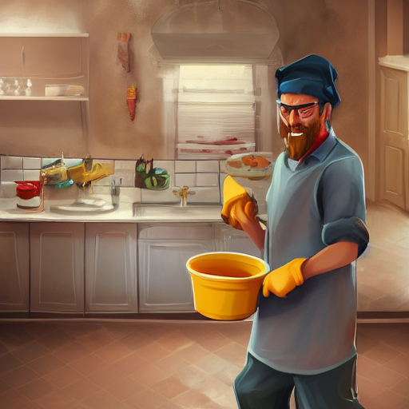
Recipes to fail
Exploration
Industrialization
Deployment & run
"Developer waiter in t-shirt in a restaurant , artstation concept art"
"Man who washes dishes in a kitchen, artstation concept art"
Project timeline
Le MLOps est une aventure Humaine – Guillaume Chervet - 1er Décembre 2022
Notes:
Now, I present you Khalid; it's our Ops. He is responsible for baking the pizza then to deliver it to the customers.

Slide 46
Recipes to fail
Exploration
Industrialization
Deployment & run
Hop
"Developer waiter in t-shirt in a restaurant , artstation concept art"
"Man who washes dishes in a kitchen, artstation concept art"
Project timeline
Le MLOps est une aventure Humaine – Guillaume Chervet - 1er Décembre 2022
Notes:
Hop, Hicham give the pizza to Khalid.

Slide 47
Recipes to fail
Exploration
Industrialization
Deployment & run
"Man who washes dishes in a kitchen, artstation concept art"
Project timeline
Le MLOps est une aventure Humaine – Guillaume Chervet - 1er Décembre 2022
Notes:
Damn, we forgot to give the instructions to Khalid. He doesn't know how to cook it (what temperature, and for how long). So, Khalid try to cook the pizza as he can.

Slide 48
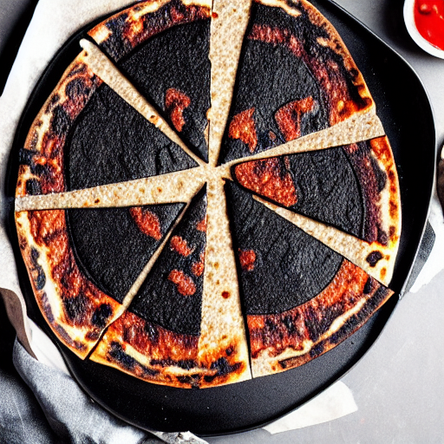
Recipes to fail
Exploration
Industrialization
Deployment & run
"Man who washes dishes in a kitchen, artstation concept art"
Project timeline
Le MLOps est une aventure Humaine – Guillaume Chervet - 1er Décembre 2022
Notes:
Unfortunately, now the pizza – without ham, and with badmy cut ingredients – is burnt. Good luck eating that!

Slide 49
Recipes to fail
Exploration
Industrialization
Deployment & run
1) Organize your teams to work in silo !
"Data scientist girl who cook with a suit in a kitchen, artstation concept art"
"Developer waiter in t-shirt in a restaurant , artstation concept art"
"Man who washes dishes in a kitchen, artstation concept art"
Project timeline
Le MLOps est une aventure Humaine – Guillaume Chervet - 1er Décembre 2022
Notes:
To sum up, here we have organized our team in silo, each role working separately, and also at the same time. It’s not a team mode. If you want to wreck your project, this is the right way to organize.
You should know that the very first choice of libraries from the start of the project has a direct impact on production. Not working together, not worrying about production from the beginning of the project, are silver bullets to make project fail.

Slide 50
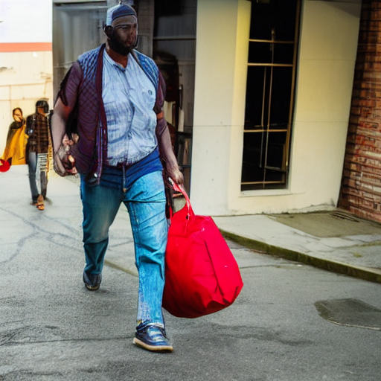
2) Come with wrong ingredients
Recipes to fail
"a man carrying a big bag"
Le MLOps est une aventure Humaine – Guillaume Chervet - 1er Décembre 2022
Notes:
Now we're going to set up the table for our customers. So, if you want to ruin a project it can be a very good idea not to focus on the user needs.
First example, on the driving license project, we were asked to read the documents in less than 10 seconds. When we started working on it, we deploy on production environment the very first algorithm that Data Scientists gave to us, the Splitter of PDF. We quickly realized that the times of one extraction took around 15 to 30 seconds, which was very problematic. The Data Scientists did not notice it because they work on overpowered machines which perform the operation very quickly.
Second example, when we were a little further on the project. We realized that some readings were very slow and clogged the systems. By looking a little more in detail at that the documents. We found that, in general, there were almost unreadable document event for a human. For this kind of case, it would have been a good idea to go see the users and to ask them if it would not be a better idea to report immediately that the document is not clean enough. It would have been better for the system and final users which wait 40 seconds before getting very bad results.

Slide 51

3) Forget customer needs
Recipes to fail
At the pizzeria
"set table with glass plates and cutlery on a table"
Le MLOps est une aventure Humaine – Guillaume Chervet - 1er Décembre 2022
Notes:
Now we're going to set up the table for our customers. So, if you want to ruin a project it can be a very good idea not to focus on the user needs.
First example, on the driving license project, we were asked to read the documents in less than 10 seconds. When we started working on it, we deploy on production environment the very first algorithm that Data Scientists gave to us, the Splitter of PDF. We quickly realized that the times of one extraction took around 15 to 30 seconds, which was very problematic. The Data Scientists did not notice it because they work on overpowered machines which perform the operation very quickly.
Second example, when we were a little further on the project. We realized that some readings were very slow and clogged the systems. By looking a little more in detail at that the documents. We found that, in general, there were almost unreadable document event for a human. For this kind of case, it would have been a good idea to go see the users and to ask them if it would not be a better idea to report immediately that the document is not clean enough. It would have been better for the system and final users which wait 40 seconds before getting very bad results.

Slide 52
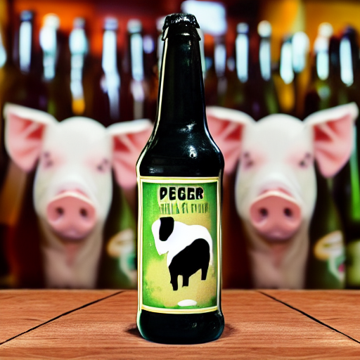
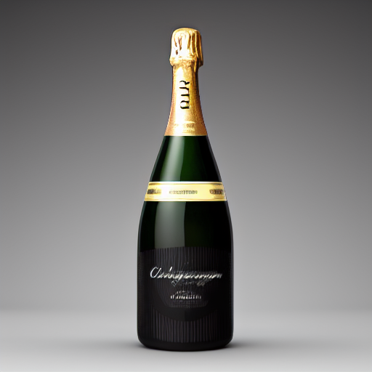
4) Use Deep Learning Everywhere
Recipes to fail
Deep Learning
Code classique
"bottle of beer with a pig on the label"
"bottle of champagne gold"
Le MLOps est une aventure Humaine – Guillaume Chervet - 1er Décembre 2022
Notes:
Now we're going to set up the table for our customers. So, if you want to ruin a project it can be a very good idea not to focus on the user needs.
First example, on the driving license project, we were asked to read the documents in less than 10 seconds. When we started working on it, we deploy on production environment the very first algorithm that Data Scientists gave to us, the Splitter of PDF. We quickly realized that the times of one extraction took around 15 to 30 seconds, which was very problematic. The Data Scientists did not notice it because they work on overpowered machines which perform the operation very quickly.
Second example, when we were a little further on the project. We realized that some readings were very slow and clogged the systems. By looking a little more in detail at that the documents. We found that, in general, there were almost unreadable document event for a human. For this kind of case, it would have been a good idea to go see the users and to ask them if it would not be a better idea to report immediately that the document is not clean enough. It would have been better for the system and final users which wait 40 seconds before getting very bad results.

Slide 53
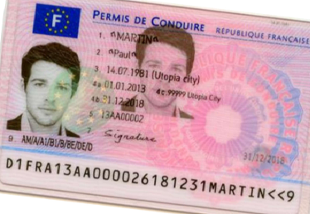
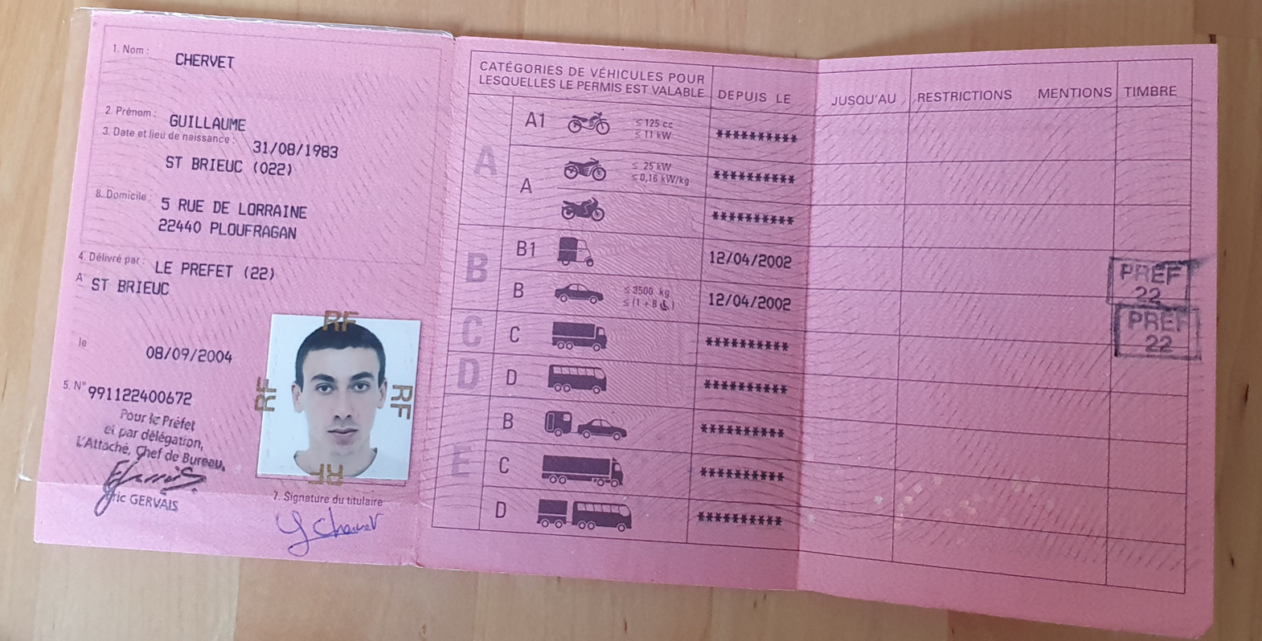
4) Use Deep Learning Everywhere
Recipes to fail
4 Go
5,5 Go
512 Mo
Orientation
Rotation
Homography
1 s
3 s
0,5 s
4 Go
5,5 Go
512 Mo
Orientation
Rotation
Homography
1 s
3 s
0,5 s
Legend :
5,5 Go
512 Mo
ML + code
Orientation
Homography
1 s
0,5 s
Only code
Le MLOps est une aventure Humaine – Guillaume Chervet - 1er Décembre 2022
Notes:
Now we're going to set up the table for our customers. So, if you want to ruin a project it can be a very good idea not to focus on the user needs.
First example, on the driving license project, we were asked to read the documents in less than 10 seconds. When we started working on it, we deploy on production environment the very first algorithm that Data Scientists gave to us, the Splitter of PDF. We quickly realized that the times of one extraction took around 15 to 30 seconds, which was very problematic. The Data Scientists did not notice it because they work on overpowered machines which perform the operation very quickly.
Second example, when we were a little further on the project. We realized that some readings were very slow and clogged the systems. By looking a little more in detail at that the documents. We found that, in general, there were almost unreadable document event for a human. For this kind of case, it would have been a good idea to go see the users and to ask them if it would not be a better idea to report immediately that the document is not clean enough. It would have been better for the system and final users which wait 40 seconds before getting very bad results.

Slide 54
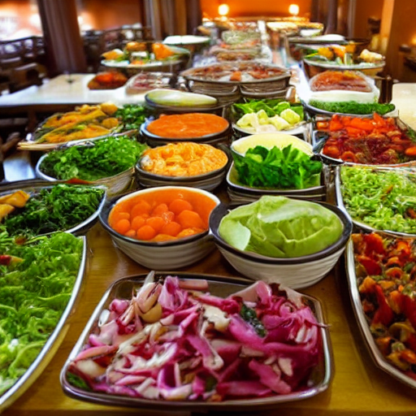
5) Only use draft “notebook”
Recipes to fail
"salad buffet in a restaurant"
Le MLOps est une aventure Humaine – Guillaume Chervet - 1er Décembre 2022
Notes:
Now we're going to set up the table for our customers. So, if you want to ruin a project it can be a very good idea not to focus on the user needs.
First example, on the driving license project, we were asked to read the documents in less than 10 seconds. When we started working on it, we deploy on production environment the very first algorithm that Data Scientists gave to us, the Splitter of PDF. We quickly realized that the times of one extraction took around 15 to 30 seconds, which was very problematic. The Data Scientists did not notice it because they work on overpowered machines which perform the operation very quickly.
Second example, when we were a little further on the project. We realized that some readings were very slow and clogged the systems. By looking a little more in detail at that the documents. We found that, in general, there were almost unreadable document event for a human. For this kind of case, it would have been a good idea to go see the users and to ask them if it would not be a better idea to report immediately that the document is not clean enough. It would have been better for the system and final users which wait 40 seconds before getting very bad results.

Slide 55
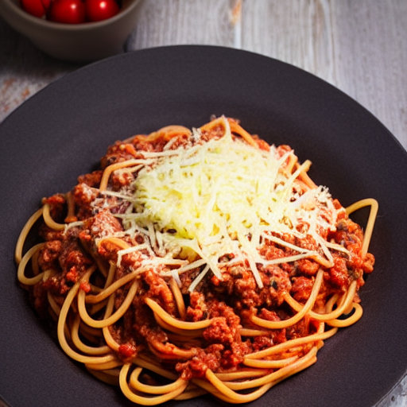
6) Messy quality code
Recipes to fail
Bolognese spagetti plate with cheese
Le MLOps est une aventure Humaine – Guillaume Chervet - 1er Décembre 2022
Notes:
Now we're going to set up the table for our customers. So, if you want to ruin a project it can be a very good idea not to focus on the user needs.
First example, on the driving license project, we were asked to read the documents in less than 10 seconds. When we started working on it, we deploy on production environment the very first algorithm that Data Scientists gave to us, the Splitter of PDF. We quickly realized that the times of one extraction took around 15 to 30 seconds, which was very problematic. The Data Scientists did not notice it because they work on overpowered machines which perform the operation very quickly.
Second example, when we were a little further on the project. We realized that some readings were very slow and clogged the systems. By looking a little more in detail at that the documents. We found that, in general, there were almost unreadable document event for a human. For this kind of case, it would have been a good idea to go see the users and to ask them if it would not be a better idea to report immediately that the document is not clean enough. It would have been better for the system and final users which wait 40 seconds before getting very bad results.

Slide 56
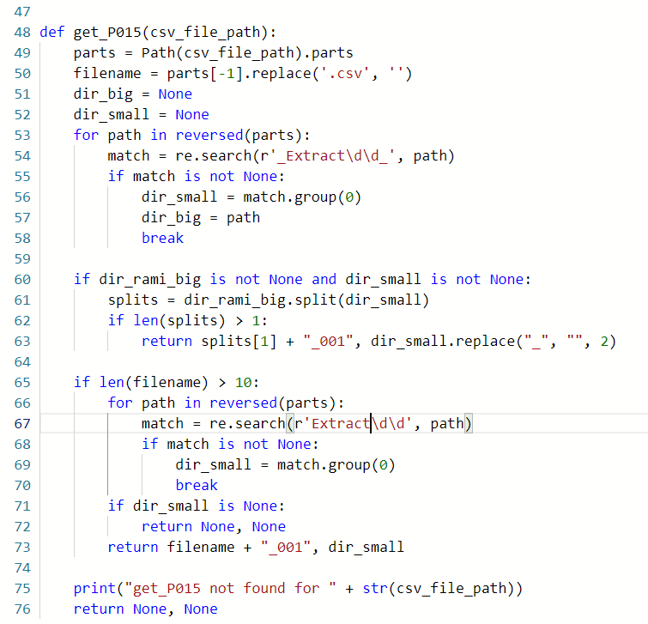
6) Messy quality code
Recipes to fail
Le MLOps est une aventure Humaine – Guillaume Chervet - 1er Décembre 2022
Notes:
Now we're going to set up the table for our customers. So, if you want to ruin a project it can be a very good idea not to focus on the user needs.
First example, on the driving license project, we were asked to read the documents in less than 10 seconds. When we started working on it, we deploy on production environment the very first algorithm that Data Scientists gave to us, the Splitter of PDF. We quickly realized that the times of one extraction took around 15 to 30 seconds, which was very problematic. The Data Scientists did not notice it because they work on overpowered machines which perform the operation very quickly.
Second example, when we were a little further on the project. We realized that some readings were very slow and clogged the systems. By looking a little more in detail at that the documents. We found that, in general, there were almost unreadable document event for a human. For this kind of case, it would have been a good idea to go see the users and to ask them if it would not be a better idea to report immediately that the document is not clean enough. It would have been better for the system and final users which wait 40 seconds before getting very bad results.

Slide 57

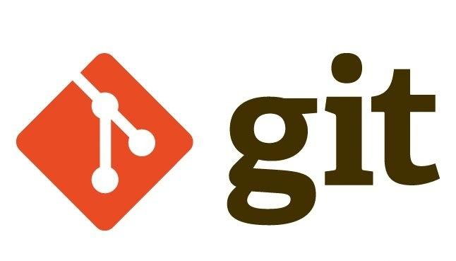
7) Split train and production code on different git
Prod Constraints
Recipes to fail
"a pinch of salt"
Le MLOps est une aventure Humaine – Guillaume Chervet - 1er Décembre 2022
Notes:
Now we're going to set up the table for our customers. So, if you want to ruin a project it can be a very good idea not to focus on the user needs.
First example, on the driving license project, we were asked to read the documents in less than 10 seconds. When we started working on it, we deploy on production environment the very first algorithm that Data Scientists gave to us, the Splitter of PDF. We quickly realized that the times of one extraction took around 15 to 30 seconds, which was very problematic. The Data Scientists did not notice it because they work on overpowered machines which perform the operation very quickly.
Second example, when we were a little further on the project. We realized that some readings were very slow and clogged the systems. By looking a little more in detail at that the documents. We found that, in general, there were almost unreadable document event for a human. For this kind of case, it would have been a good idea to go see the users and to ask them if it would not be a better idea to report immediately that the document is not clean enough. It would have been better for the system and final users which wait 40 seconds before getting very bad results.

Slide 58
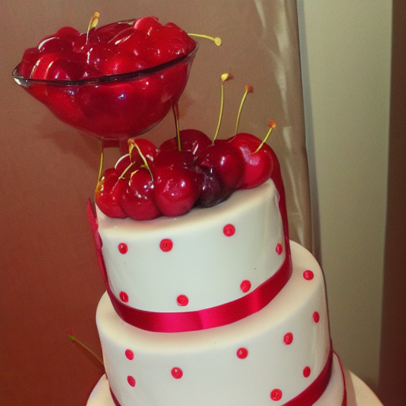
8) Let the data drift happen
Recipes to fail
"cherry on the cake"
Le MLOps est une aventure Humaine – Guillaume Chervet - 1er Décembre 2022
Notes:
Now we're going to set up the table for our customers. So, if you want to ruin a project it can be a very good idea not to focus on the user needs.
First example, on the driving license project, we were asked to read the documents in less than 10 seconds. When we started working on it, we deploy on production environment the very first algorithm that Data Scientists gave to us, the Splitter of PDF. We quickly realized that the times of one extraction took around 15 to 30 seconds, which was very problematic. The Data Scientists did not notice it because they work on overpowered machines which perform the operation very quickly.
Second example, when we were a little further on the project. We realized that some readings were very slow and clogged the systems. By looking a little more in detail at that the documents. We found that, in general, there were almost unreadable document event for a human. For this kind of case, it would have been a good idea to go see the users and to ask them if it would not be a better idea to report immediately that the document is not clean enough. It would have been better for the system and final users which wait 40 seconds before getting very bad results.

Slide 59

9) Focus on statistics and forget the rest
Recipes to fail
"one coffee on a table"
Le MLOps est une aventure Humaine – Guillaume Chervet - 1er Décembre 2022
Notes:
Now we're going to set up the table for our customers. So, if you want to ruin a project it can be a very good idea not to focus on the user needs.
First example, on the driving license project, we were asked to read the documents in less than 10 seconds. When we started working on it, we deploy on production environment the very first algorithm that Data Scientists gave to us, the Splitter of PDF. We quickly realized that the times of one extraction took around 15 to 30 seconds, which was very problematic. The Data Scientists did not notice it because they work on overpowered machines which perform the operation very quickly.
Second example, when we were a little further on the project. We realized that some readings were very slow and clogged the systems. By looking a little more in detail at that the documents. We found that, in general, there were almost unreadable document event for a human. For this kind of case, it would have been a good idea to go see the users and to ask them if it would not be a better idea to report immediately that the document is not clean enough. It would have been better for the system and final users which wait 40 seconds before getting very bad results.

Slide 60

Recipes to fail
Recipes to fail
10) Write a big check
"invoice made of gold"
Le MLOps est une aventure Humaine – Guillaume Chervet - 1er Décembre 2022
Notes:
Time to pay the bill!
You don't have to wait for someone to come to you to start paying attention if the project is too expensive.
The planet has limited resources, so please, you should always think about consuming as few resources as possible.
If your project is too expensive, it may be stopped.

Slide 61
Today Agenda
Introduction to AI and Deep Learning
Production architecture constraints
AXA Lessons Learned in MLOps
Recipes to fail an ML project
How to stack the odds in your favor ?
Le MLOps est une aventure Humaine – Guillaume Chervet - 1er Décembre 2022
Notes:
In this part we are going to give feedbacks based on different experiences. This allowed us to learn what NOT to do.
To make it fun, we are going to open a pizzeria and we are going to organize to serve pizzas to our customers. We're going to put everything in place to make our pizzeria fails to deliver a good meal.

Slide 62
Exploration phase
Recipes to win
Le MLOps est une aventure Humaine – Guillaume Chervet - 1er Décembre 2022
Notes:
We will start from the exploration phase. What is important from the beginning in the organization of the project is to make all the actors work together toward a single objective: make the project work in production.
Focus on humans, make sure everyone share their own problems, make your everyone understands the problems of others, make sure everyone is working together on their resolution.
This is really the heart of the success of a project. This is also why the title of this presentation is called MLOPS is a human adventure, it is really a culture of sharing associated with the fact of trusting each other.
In this exploration phase, will make it possible to estimate whether the project is feasible or not.

Slide 63
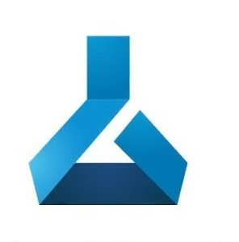


Exploration phase
Recipes to win
AzureML dev
Annotations
+
Data
Automated Training Pipeline
Model Registry
Le MLOps est une aventure Humaine – Guillaume Chervet - 1er Décembre 2022
Notes:
At AXA France we work on AI issues directly on production with production data.
To secure this, we will ask Khalid our Ops to deploy a development environment on production network. Only few people will have access to this environment on AzureML.

Slide 64

Exploration phase
Recipes to win
AzureML dev
Annotations
+
Data
Automated Training Pipeline
Data Validation
Data Preparation
Model Training
Model Evaluation
Model Registry
Model Register
Le MLOps est une aventure Humaine – Guillaume Chervet - 1er Décembre 2022
Notes:
From the beginning Elisabeth and Hicham will work together from GIT and a DataLake.
It will mainly be Elisabeth who will be active on the first phase but accompanied by Hicham who knows production difficulties.

Slide 65
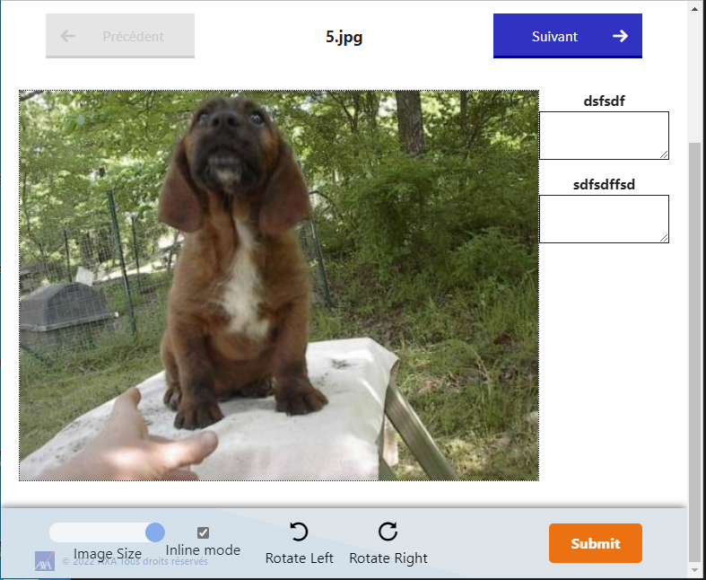
Exploration phase
Recipes to win
Ecotag
AzureML dev
Annotations
+
Data
Automated Training Pipeline
Data Validation
Data Preparation
Model Training
Model Evaluation
Model Registry
Model Register
Le MLOps est une aventure Humaine – Guillaume Chervet - 1er Décembre 2022
Notes:
Quite quickly we will have to start a labelling phase.
We're going to find Lilian again.
It is very important to work in collaboration with the team that is going to label the data. Why? Because Data is your gold.
What we will do, is that we will first make small batches of data. Which will be used to refine the labelling rules. It is extremely important that the labels are carried out in the same way by everyone.
Imagine you have to Zone some cats on images. Imagine you have a cat that is on a table and its tail disappears under the table and becomes visible again on the other side. An annotator may Zone the cat without the piece of tail and another one may select the cat with the full tail.
With, this kind of data, the AI ​​will not be able to learn well. It is very important to choose common rules, to refine the labelling rules according to each specific case that we encounter.
Once the rules are well defined, the volume of labelling data can be increased.

Slide 66
Exploration phase
Recipes to win
AzureML dev
Annotations
+
Data
Automated Training Pipeline
Data Validation
Data Preparation
Model Training
Model Evaluation
Model Registry
Model Register
Le MLOps est une aventure Humaine – Guillaume Chervet - 1er Décembre 2022
Notes:
Once we have labelled the data, we can train a model.
Then, to automate and save time; we will set up a continuous integration which will allow us to be able to replay the training automatically, almost industrially.
The deliverable: it is not the model. It's the CODE in GIT plus the DATA versioned in a DataLake.
You model will be reproductible !

Slide 67
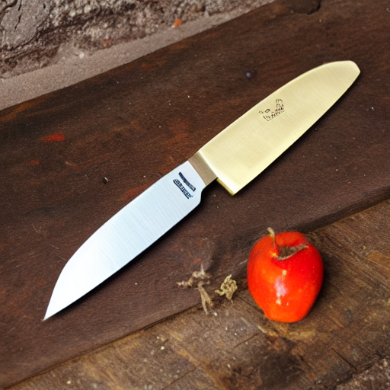
Exploration phase
Recipes to win
AzureML dev
Annotations
+
Data
Automated Training Pipeline
Data Validation
Data Preparation
Model Training
Model Evaluation
Model Registry
Model Register
AI metrics
Estimate production cost
Estimate response time
Train code & data
Le MLOps est une aventure Humaine – Guillaume Chervet - 1er Décembre 2022
Notes:
We can see that we already have a well-spread pizza dough with all our ingredients and a knife ready to use, so, we really have everything we need.
At the end of this step, we must all together be able to estimate the metrics.
Prediction quality
Production infrastructure
Response time
We already have a versioned quasi-industrial training code and the versioned data, this is our deliverable

Slide 68
Industrialization phase
Recipes to win
Le MLOps est une aventure Humaine – Guillaume Chervet - 1er Décembre 2022
Notes:
We will be able to enter to the industrialization phase where the goal will be to develop and bring into production APIs that host the models.

Slide 69
Recipes to win
AzureML dev
Automated Training Pipeline
Data Validation
Data Preparation
Model Training
Model Evaluation
Model Registry
Model Register
Industrialization phase
Le MLOps est une aventure Humaine – Guillaume Chervet - 1er Décembre 2022
Notes:
We are going to set up continuous integration which will allow us to build docker images. We retrieve models from a model registry then build our APIs inside a DOCKER image then push it into a docker registry.

Slide 70
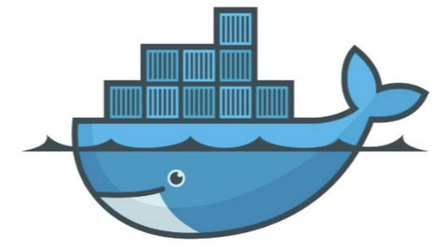
Recipes to win
AzureML dev
Automated Training Pipeline
Data Validation
Data Preparation
Model Training
Model Evaluation
Model Registry
Model Register
Docker registry
Industrialization phase
Le MLOps est une aventure Humaine – Guillaume Chervet - 1er Décembre 2022
Notes:
At AXA France, we deploy our docker images on OpenShift. We will ask our OPS to set up the development and staging environments. We deliver using GITOPS method. We use 4 GIT branches, one for the development environment, one for the staging, 2 others for pre-production and production.
This will allow us to be able to deploy our applications via GIT manipulation.

Slide 71

Recipes to win
AzureML dev
Automated Training Pipeline
Data Validation
OpenShift dev
Data Preparation
Model Training
zoning
ocr
homography
Model Evaluation
Model Registry
Model Register
OpenShift rec
zoning
ocr
homography
Docker registry
Industrialization phase
Le MLOps est une aventure Humaine – Guillaume Chervet - 1er Décembre 2022
Notes:
At AXA France, we deploy our docker images on OpenShift. We will ask our OPS to set up the development and staging environments. We deliver using GITOPS method. We use 4 GIT branches, one for the development environment, one for the staging, 2 others for pre-production and production.
This will allow us to be able to deploy our applications via GIT manipulation.

Slide 72
Recipes to win
AzureML dev
Automated Training Pipeline
OpenShift dev
Integration Test
Model Registry
zoning
ocr
homography
OpenShift rec
zoning
ocr
homography
Docker registry
Industrialization phase
Le MLOps est une aventure Humaine – Guillaume Chervet - 1er Décembre 2022
Notes:
Today we are also quasi able to deploy from one git commit from the GIT with the code and auto deploy in openshift development environment then play integration tests that compute, remember the triangle : “response time”, “prediction quality” and “infrastructure cost”.
One manual action to get the real feedback from an iso production environment, this is our Holy Grail !
So we check that we have the same quality of prediction as in training.
We also check the response time and finely configure the sizing of the infrastructures.

Slide 73
Recipes to win
AzureML dev
Automated Training Pipeline
Data Validation
OpenShift dev
Data Preparation
Model Training
zoning
ocr
homography
Model Evaluation
Model Registry
Model Register
OpenShift rec
zoning
ocr
homography
Docker registry
Industrialization phase
Le MLOps est une aventure Humaine – Guillaume Chervet - 1er Décembre 2022
Notes:
Once the development environment is validated. We can deploy in staging.
To do this, we make a PullRequest on the staging branch.

Slide 74
Recipes to win
AzureML dev
Automated Training Pipeline
Data Validation
OpenShift dev
Data Preparation
Model Training
zoning
ocr
homography
Model Evaluation
Model Registry
Model Register
OpenShift rec
zoning
ocr
homography
AzureML prod
Automated Training Pipeline
Data Validation
Data Preparation
Model Training
Model Evaluation
Model Registry
Model Register
Industrialization phase
Le MLOps est une aventure Humaine – Guillaume Chervet - 1er Décembre 2022
Notes:
At that point we will enter to another phase of the project. We will ask our Ops to create a new AzureML training environment still on production. On this environment, we will only have read-only access.

Slide 75
Recipes to win
AzureML dev
Automated Training Pipeline
Data Validation
OpenShift dev
Data Preparation
Model Training
zoning
ocr
homography
Model Evaluation
Model Registry
Model Register
OpenShift rec
zoning
ocr
homography
OpenShift pre-prod
Docker registry
AzureML prod
zoning
ocr
homography
Automated Training Pipeline
OpenShift prod
Data Validation
Data Preparation
Model Training
zoning
ocr
homography
Model Evaluation
Model Registry
Model Register
Industrialization phase
Le MLOps est une aventure Humaine – Guillaume Chervet - 1er Décembre 2022
Notes:
We are going to set up a very BIG pipeline that allow us to retrain the whole pipeline automatically.

Slide 76
Recipes to win
AzureML dev
Automated Training Pipeline
Data Validation
OpenShift dev
Data Preparation
Model Training
zoning
ocr
homography
Model Evaluation
Model Registry
Model Register
OpenShift rec
zoning
ocr
homography
OpenShift pre-prod
Docker registry
AzureML prod
zoning
ocr
homography
Automated Training Pipeline
OpenShift prod
Data Validation
Data Preparation
Model Training
zoning
ocr
homography
Model Evaluation
Model Registry
Model Register
Industrialization phase
Le MLOps est une aventure Humaine – Guillaume Chervet - 1er Décembre 2022
Notes:
We can now, via GIT manipulations, deploy on the development environment and then validate it.

Slide 77
Deployment & run
Recipes to win
AzureML dev
Automated Training Pipeline
Data Validation
OpenShift dev
Data Preparation
Model Training
zoning
ocr
homography
Model Evaluation
Model Registry
Model Register
OpenShift rec
zoning
ocr
homography
OpenShift pre-prod
Docker registry
AzureML prod
zoning
ocr
homography
Automated Training Pipeline
OpenShift prod
Data Validation
Data Preparation
Model Training
zoning
ocr
homography
Model Evaluation
Model Registry
Model Register
Le MLOps est une aventure Humaine – Guillaume Chervet - 1er Décembre 2022
Notes:
We deploy in staging and validate it.

Slide 78
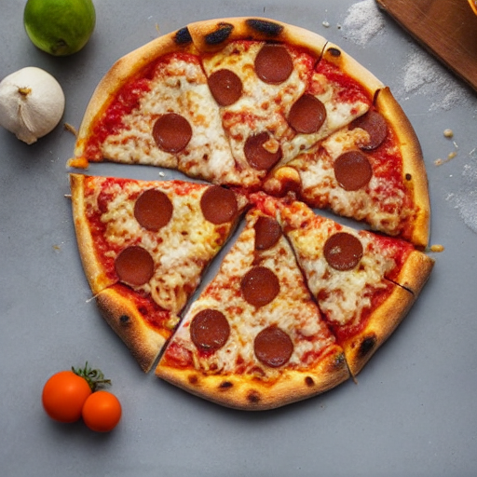
Deployment & run
Recipes to win
AzureML dev
Automated Training Pipeline
Data Validation
OpenShift dev
Data Preparation
Model Training
zoning
ocr
homography
Model Evaluation
Model Registry
Model Register
OpenShift rec
zoning
ocr
homography
OpenShift pre-prod
Docker registry
AzureML prod
zoning
ocr
homography
Automated Training Pipeline
OpenShift prod
Data Validation
Data Preparation
Model Training
zoning
ocr
homography
Model Evaluation
Model Registry
Model Register
Le MLOps est une aventure Humaine – Guillaume Chervet - 1er Décembre 2022
Notes:
At this stage, we already have a pizza that is almost pre-cooked.

Slide 79
Deployment & run
Recipes to win
AzureML dev
Automated Training Pipeline
Data Validation
OpenShift dev
Data Preparation
Model Training
zoning
ocr
homography
Model Evaluation
Model Registry
Model Register
OpenShift rec
zoning
ocr
homography
OpenShift pre-prod
Docker registry
AzureML prod
zoning
ocr
homography
Automated Training Pipeline
OpenShift prod
Data Validation
Data Preparation
Model Training
zoning
ocr
homography
Model Evaluation
Model Registry
Model Register
Le MLOps est une aventure Humaine – Guillaume Chervet - 1er Décembre 2022
Notes:
For safety, we do not have the rights to deliver in preproduction. Only the OPS can do it and they will deliver this pre-cooked pizza in pre-production. Then we validate the environment.

Slide 80
Deployment & run
Recipes to win
AzureML dev
Automated Training Pipeline
Data Validation
OpenShift dev
Data Preparation
Model Training
zoning
ocr
homography
Model Evaluation
Model Registry
Model Register
OpenShift rec
zoning
ocr
homography
OpenShift pre-prod
Docker registry
AzureML prod
zoning
ocr
homography
Automated Training Pipeline
OpenShift prod
Data Validation
Data Preparation
Model Training
zoning
ocr
homography
Model Evaluation
Model Registry
Model Register
Le MLOps est une aventure Humaine – Guillaume Chervet - 1er Décembre 2022
Notes:
Then Khalid deploys to production. Yeah 😊

Slide 81
Deployment & run
Recipes to win
Le MLOps est une aventure Humaine – Guillaume Chervet - 1er Décembre 2022
Notes:
he model API is deployed and follows the monitoring

Slide 82
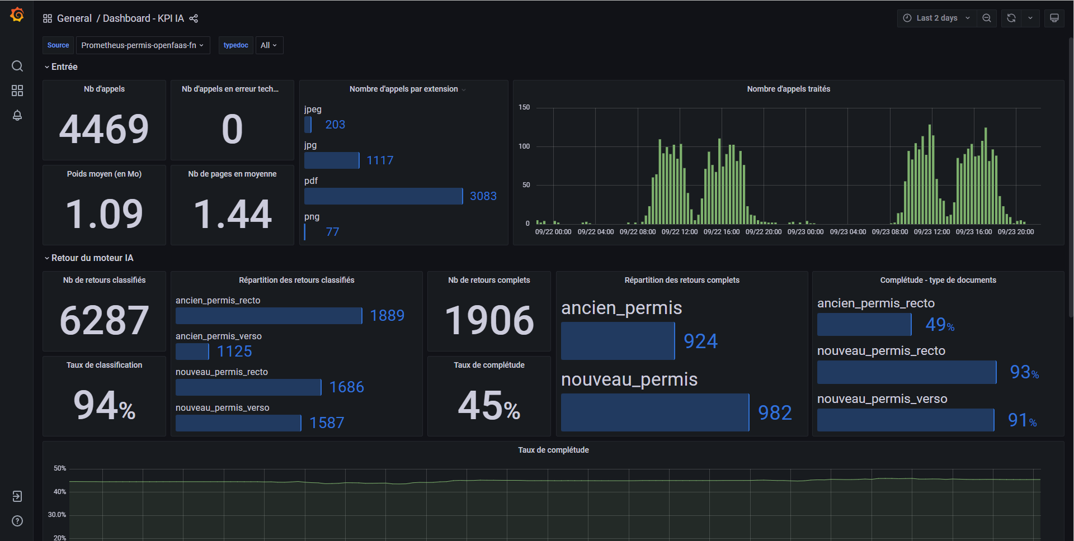
Recipes to win
Le MLOps est une aventure Humaine – Guillaume Chervet - 1er Décembre 2022
Notes:
For the moment, for monitoring Data Drift we are using Prometheus and Grafana
This monitoring allows us to easily link the metrics send some alerts. Alerts are sent to another team specialized in production.
Subsequently, we work on setting up the feedback loop and we will rather connect to this feedback loop to set up much finer metrics and alerting.

Slide 83
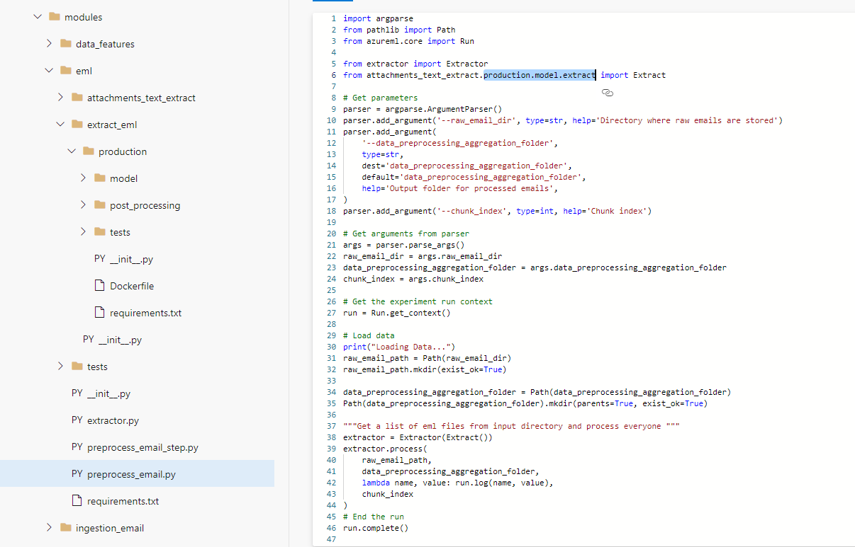
Recipes to win
Le MLOps est une aventure Humaine – Guillaume Chervet - 1er Décembre 2022
Notes:
Today we have 2 ways to share code inside the same GIT.
We set up a directory named production. As in python everything is a module, the training code uses some modules called production to perform inference for scoring.

Slide 84
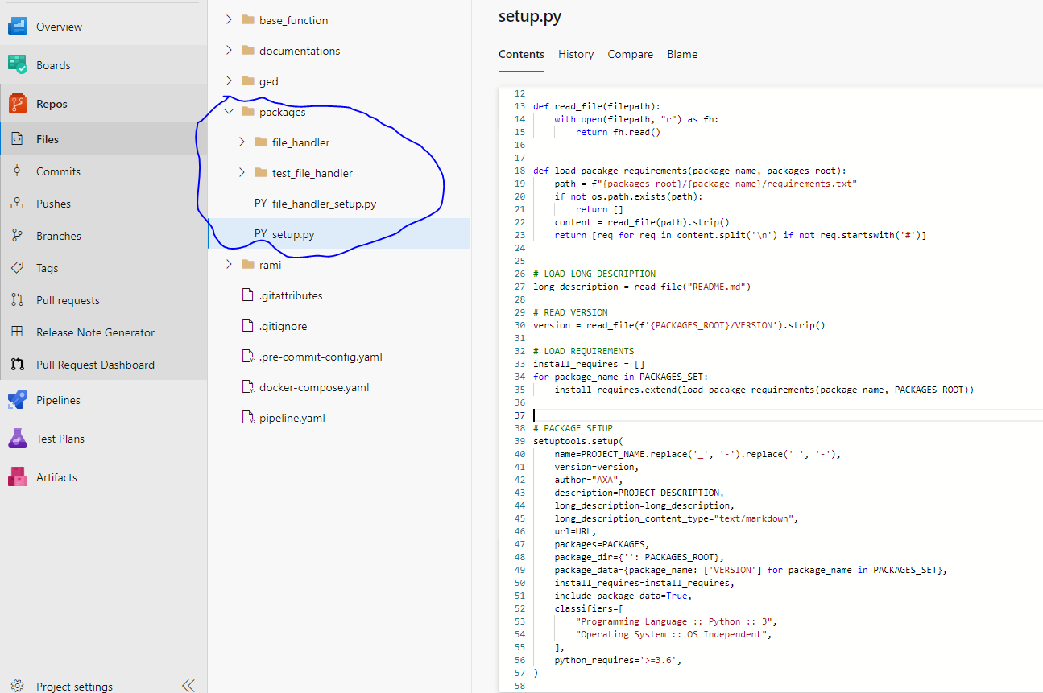
Recipes to win
Le MLOps est une aventure Humaine – Guillaume Chervet - 1er Décembre 2022
Notes:
Another technique, we are testing to share code by making local python packages.

Slide 85
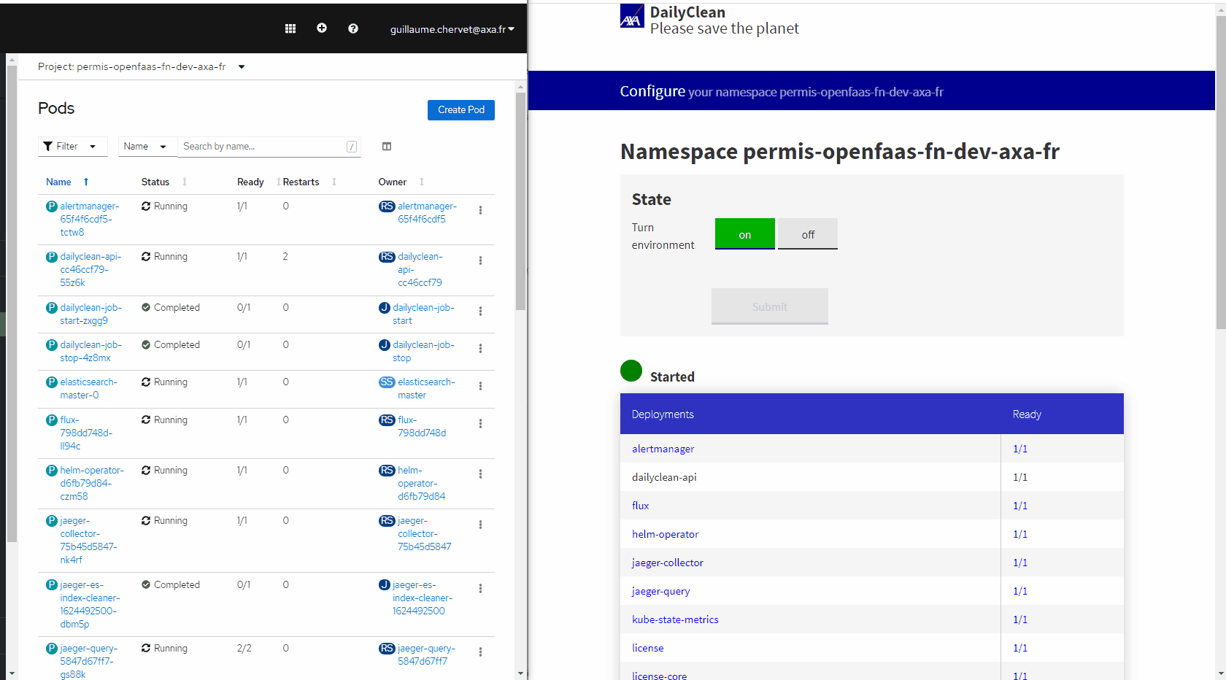
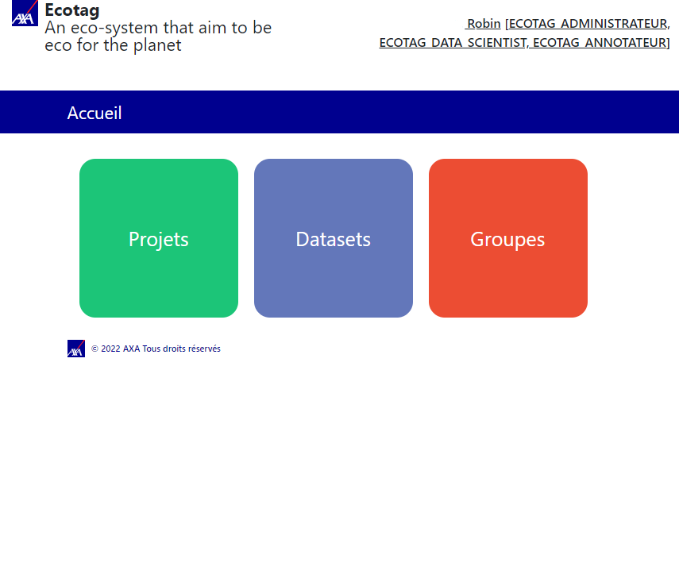
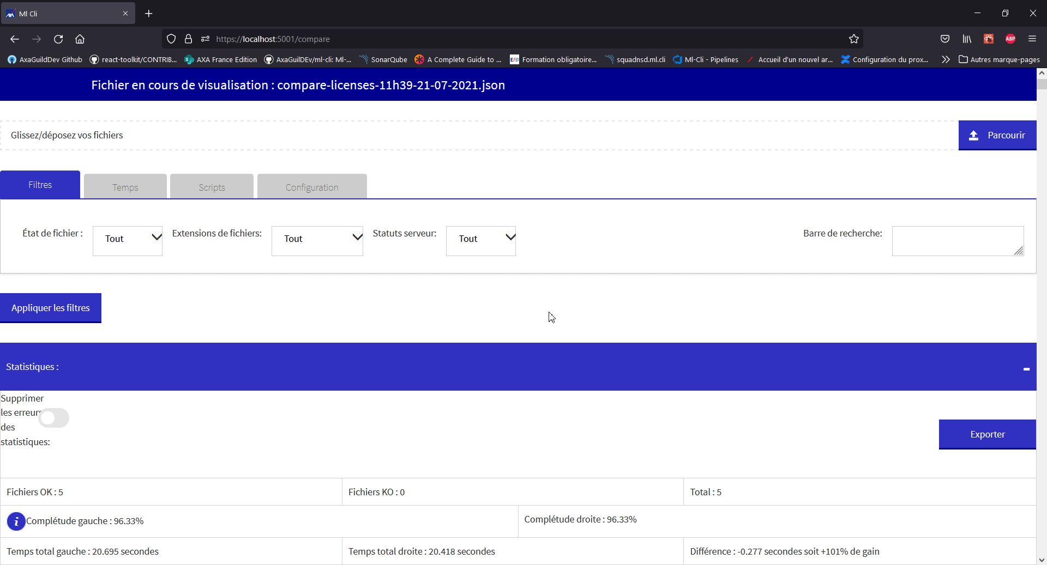
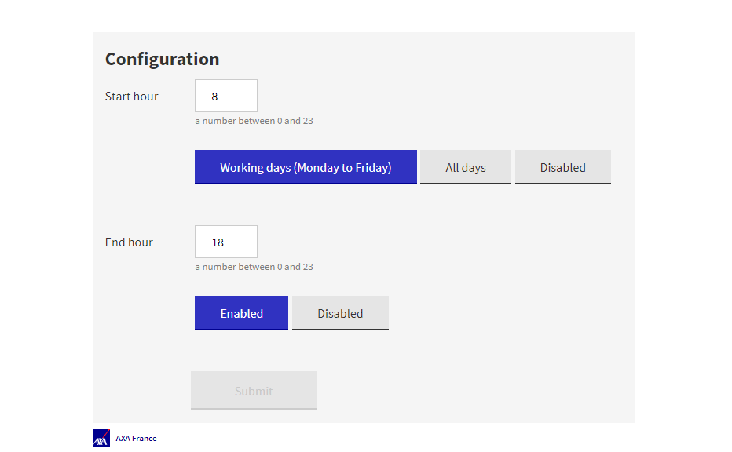
Open Source
Recipes to win
Dailyclean
Ecotag
ML-Cli
Le MLOps est une aventure Humaine – Guillaume Chervet - 1er Décembre 2022
Notes:
MLOPS is not centered on tools, however thanks to our projects, we have been able to set up tools and open source them. It is a pleasure to share them with you.
The daily clean allows us to automatically shut down Kubernetes environment.
Ecotag allows us to make labelling and comply with GDPR rules.
ml-cli is our integration test tool.

Slide 86

Conclusion
"three people hugging"
Le MLOps est une aventure Humaine – Guillaume Chervet - 1er Décembre 2022
Notes:
To conclude, MLOPS is above all a culture of sharing.
Today we have projects that are at the top of the top of the complexity and if we do not put everything in place to help experts to work together.
To understand that the problem of one is the problem of the other.
It can't work.
A production ready project should also be a final focus.
The key to success comes in this sharing and working together.
Et finalement AXA =>
Transversale, amelioration continue.
Bonne pratique Déploiment, Code, Collaboration. => itéré rapidement donc droit à l’erreur
Dur avec le code doux avec les gens.
J’ai eu du plaisir à réaliser ce partage, avez-vous des questions?

Slide 87
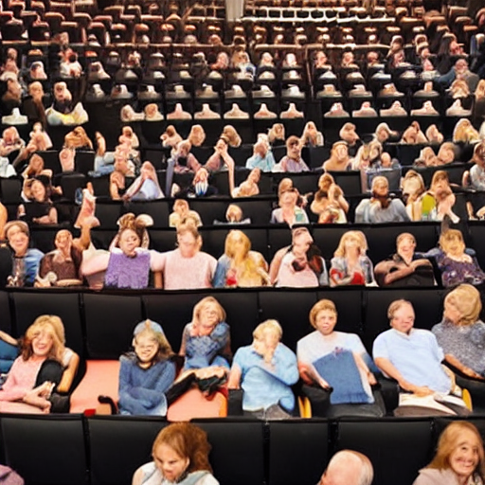
Thank you ☺
"thank and hug the public in a theater"
Le MLOps est une aventure Humaine – Guillaume Chervet - 1er Décembre 2022

Slide 89
Use Deep Learning Everywhere
Recipes to fail
Zoning
Zoning
Notes:
Last example for our aperitif, for the text detection, we tried to replace these Custom Deep Learning algorithms by open-source algorithm available on internet. The only difference, Open-Source Algorithm are worst at detecting text on unreadable documents by humans.
If we had excluded these illegible documents from the start, we could have used this algorithm and thus gained TimeToMarket and made a lot of money.

Slide 91



Slide 92
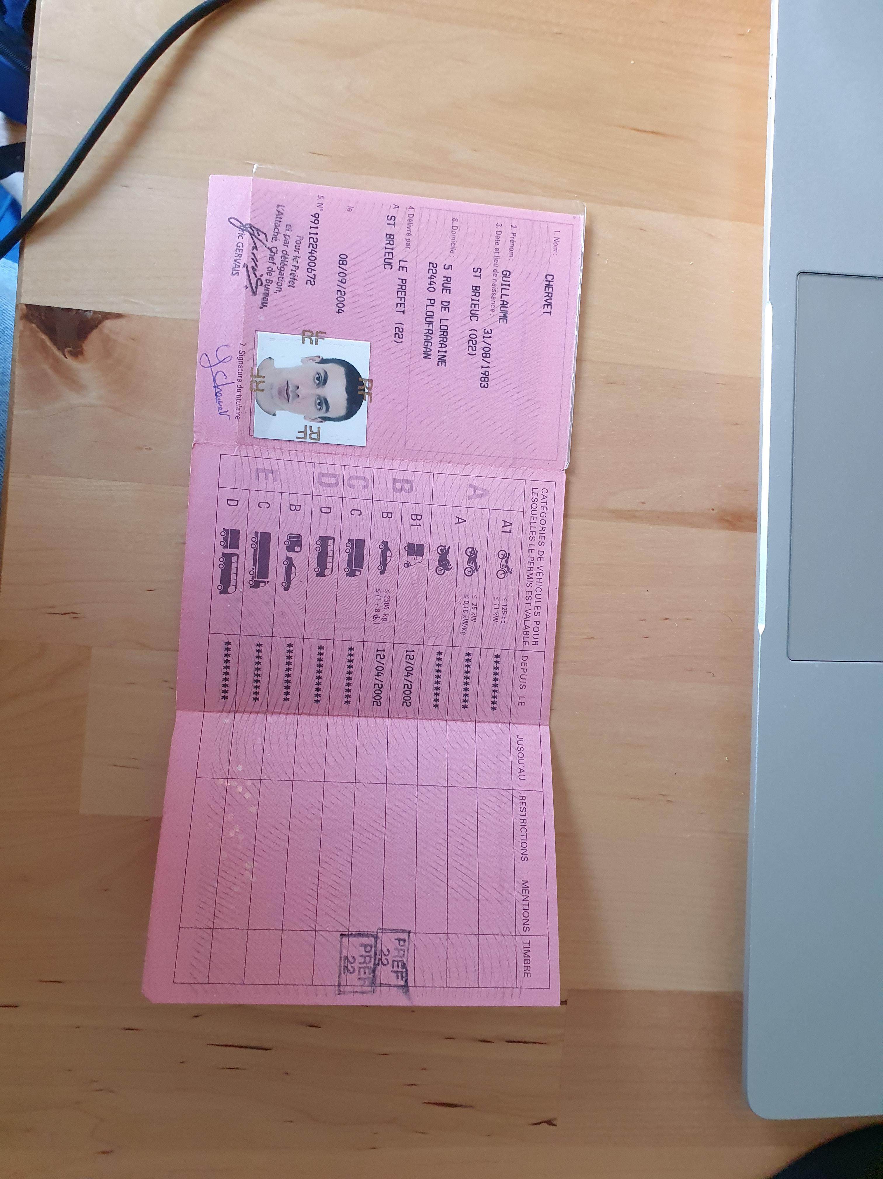

Production
OCR
Split
Zoning
Homography
Zoning
Classifier
Rotation
Zoning
OCR
Notes:
Guillaume
10 mins

Slide 93
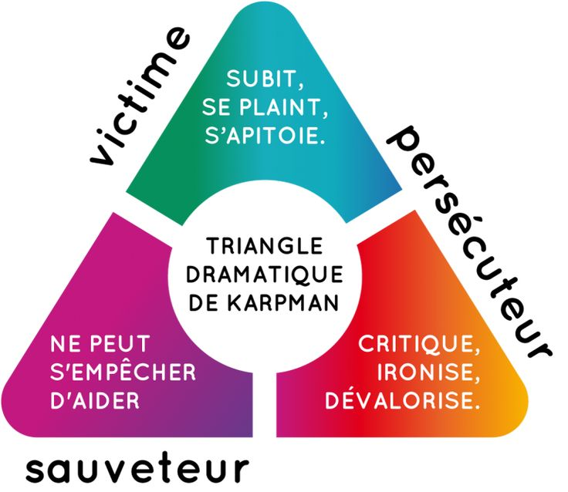
triangle de cartman
Notes:
- On passe de duo a trio
- On est dans l’innovation

Slide 94

Phase exploratoire : Est-que le projet est faisable ?
Phase production : Faire le projet.
Hot
"one potatoe with white smoke"
Notes:
Pas de versionning,
Pas d’industrialisation des scripts pour générer

Slide 95
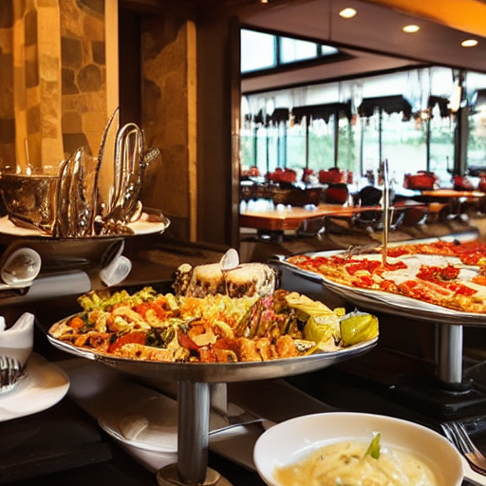
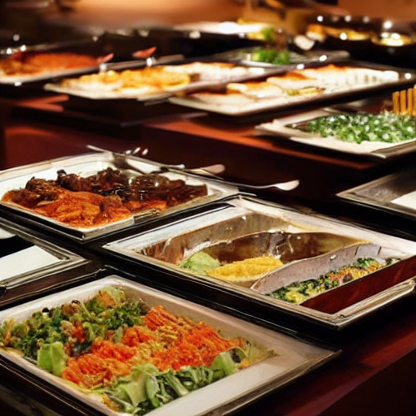

Slide 96
Type d’algorithme
Deep Learning
Machine
Learning
Code classique
Itération rapide
Résilient aux changements
Peux couteux en temps/RAM/CPU
Ne pourra pas couvrir 100% des cas
Réutilisable
Algorithmes pas tous déterministe
Itération Longue
Peu résilient aux changements
Couteux en temps/RAM/CPU
Couvrira les cas simple (structuré)
Itération très longue
Peu résilient aux changements
Très couteux en temps/RAM/CPU
Permet de tendre vers une couverture fonctionnelle de 100% des cas

Slide 97
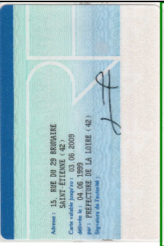
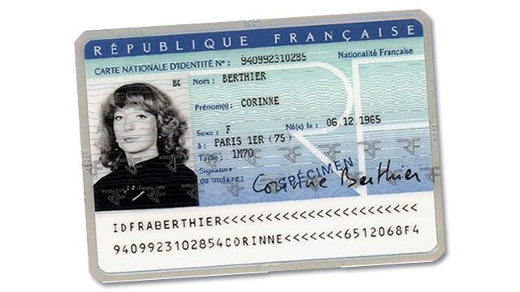

78%
Page
Zoning
Homography
Zoning
OCR
85%
Split
Split
Zoning
Homography
Zoning
OCR
Notes:
Guillaume
10 mins

Slide 98
Experimentation phase
Choose an ML and/or classical algorithm and code your model
Tune the model hyperparameters
Identify problem and collect and analyse data
Transform data
&
annotate
Experiment with data and model training
Iterate Tuning and training

Slide 99
Recipes to fail
"one potatoe with white smoke"
Notes:
Pas de versionning,
Pas d’industrialisation des scripts pour générer

Slide 100
Production phase
Transform data
&
annotate
Monitor the model’s performances
Train
&
validate
Serve in production
Iterate Tuning and training

Slide 101
Un projet complexe chaînant plusieurs algorithmes de DeepLearning c’est bien, un projet ML qui fonctionne en production, c’est encore mieux :] Qui fonctionne en production ? Exécution rapide, Qualité de prédiction identique entre l’entrainement et la production, Monitoré et re-livrable très rapidement en cas de problème, Pas trop cher et vous rapporte des sous Bref un projet qui répond aux besoins des utilisateurs ! Le constat est que beaucoup de projets ML échouent à l’étape : passer en production, pour plusieurs raisons que nous détaillerons. Nous représenterons les étapes de l’entrainement d’un ou plusieurs algorithmes IA. Puis nous vous ferons un retour d’expériences sur nos échecs riches en apprentissages et bien sûr nos succès c’est-à-dire des projets en production qui dépotent. Cette présentation s'adresse à tout public (Développeur, DataScientist, Ops, Manageur, etc..)

Slide 102
Architecture
Monolithe
Micro service
Fast iteration
Very slow iteration

Slide 103
Recipes to fail
Exploration
Industrialisation
Deployment & run
"Data scientist girl who cook with a suit in a kitchen, artstation concept art"
"Developer waiter in t-shirt in a restaurant , artstation concept art"
"Man who washes dishes in a kitchen, artstation concept art"
Project timeline
Notes:
Exemple avec les rôles qui interviennent sur RAMI
Exemple aussi sur Clear
Exemple Carto

Slide 104
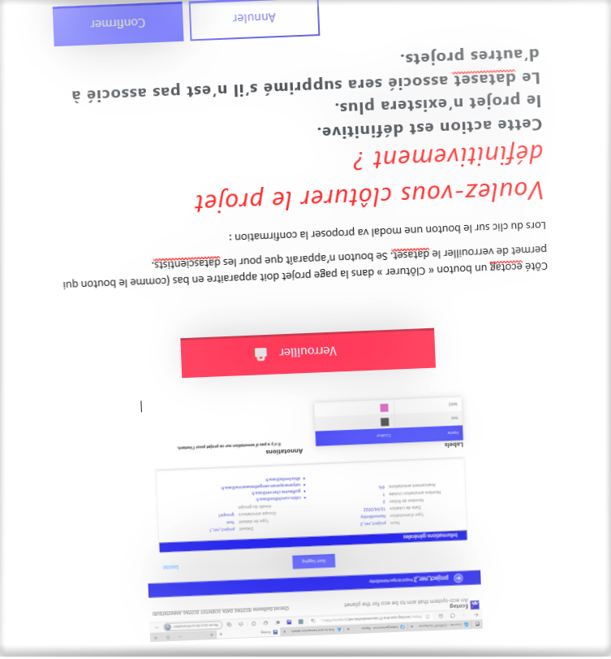
Use Deep Learning Everywhere
Recipes to fail
Notes:
We had the same problem with the email classification project. We had a deep learning algorithm to straighten out the documents. It wasn't doing it well and it took even longer than reading the document itself. So, we insisted on looking for algorithms and we managed to replace it without AI. Now execution is fast, less than 0.3 seconds and with very few resources consumed.
And who knows, if tomorrow we want to improve the performance and if we have the budget, we can train an AI.

